Slide 1
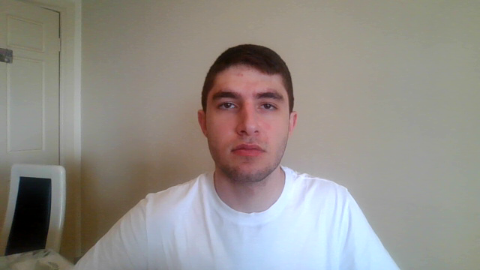
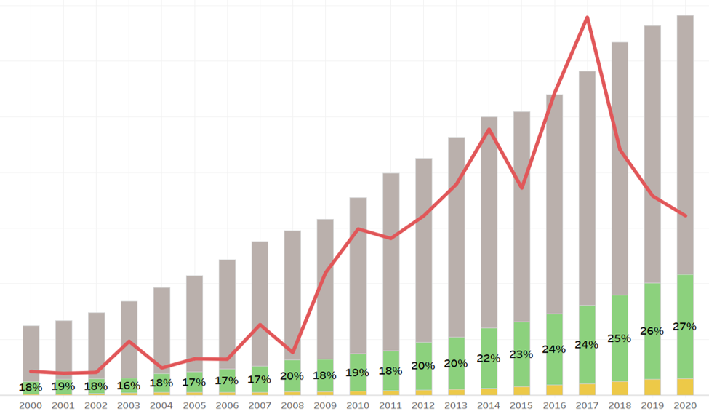
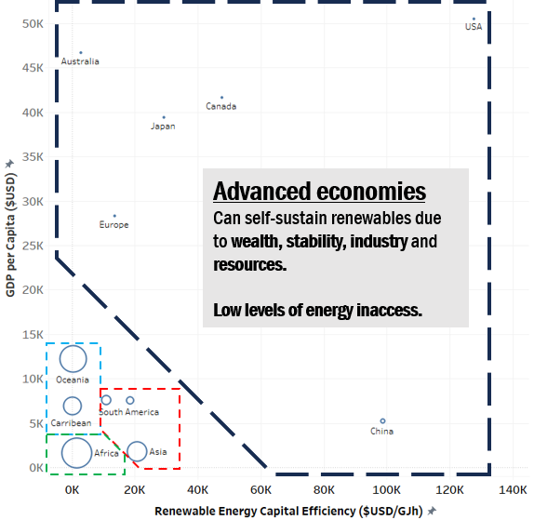
Logical Steps to a solution
7.1 – Universal access to reliable energy
7.2 – Increasing the share of renewables in energy mix
Countries not adept in achieving 7.1 face higher challenge in 7.2
Countries adept in achieving 7.1 show promise in achieving 7.2
Main reasons:
dependence on public funding, higher cost of capital for investment
Main reasons:
Stronger renewable energy grid capacity, economies of scale, GDP
Remember these?
Notes:
Well, low energy access regions struggle with renewables uptake while regions with universality show more promise for reasons already discussed.

Slide 2
Logical Steps to a solution
7.1 – Universal access to reliable energy
7.2 – Increasing the share of renewables in energy mix
Countries not adept in achieving 7.1 face higher challenge in 7.2
Countries adept in achieving 7.1 show promise in achieving 7.2
Development of a grouping or BRACKET SYSTEM
Expectations of nations action plan determined by tiering
Notes:
To manage conflicting priorities a bracketing system | could define the appropriateness

Slide 3
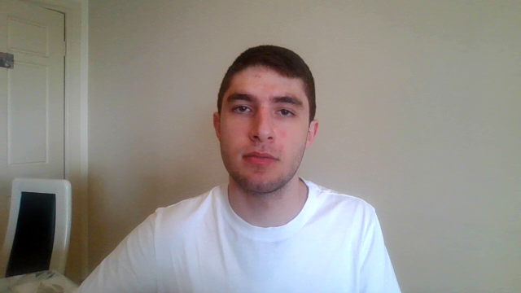
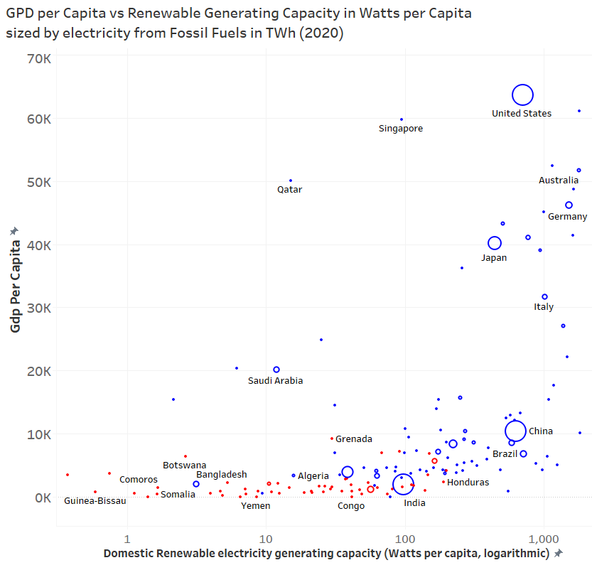

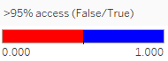
















































Mock-Up of Tiering System
1+2: Energy developed
Universal energy access
Larger Renewables Capacity
Higher Fossil Fuels Use
Higher GDP per Capita + manufacturing
3+4: Energy developing
Yet to achieve universality
Weaker renewables capacity
Lower contribution to global fossil fuels
Lower GDP per capita + manufacturing
Notes:
could define the appropriateness of each nations goals based off criteria such as the current state of access, renewables vs fossil fuel use and GDP.

Slide 4
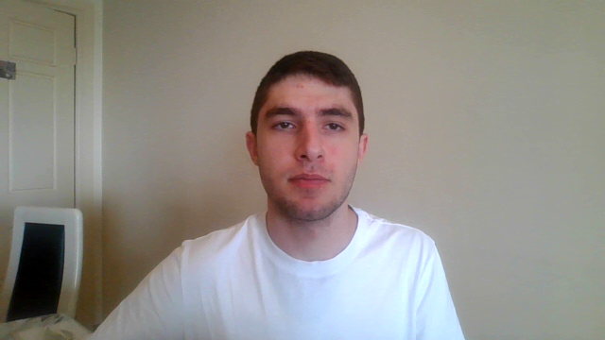






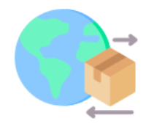

Possible Actionables of Bracketing System
Energy developed
Energy developing
Halt fossil fuel expansion by 2030
Freedom of choice in energy source
Double renewables share by 2030
Innovation and technology to overcome natural hurdles.
Abolish restrictive patents and IP copyrights, introduce utility models
Use of Blended finance to reduce risk and cost of capital of foreign investment
Increase trade flows between raw goods and manufactures for renewables e.g. batteries
Increase training programs to mobilise human capital in energy sectors
Notes:
Developed nations are treated to stricter deadlines and responsibilities they have stronger capabilities for, while provisions are granted to the developing such as blended finance, training programs and RND. This way, renewables are elevated globally, while universality is prioritized adequately.

Slide 5

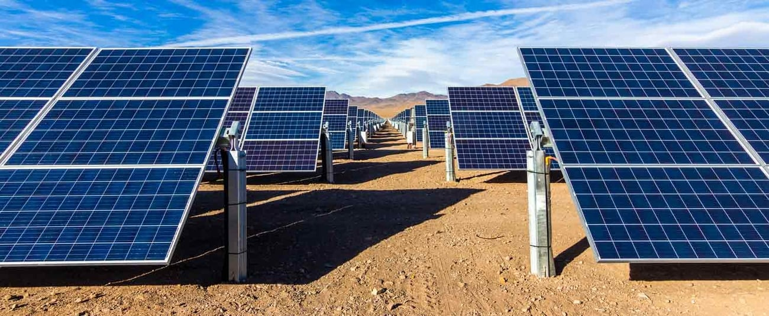
Final remarks: What responsibilities should the UN encourage?
1. Renewable savvy nations should double-down
2. Barriers to energy poor nations should fall
3. Collaboration by governments and private investors to fund projects
4. Ensures a cleaner and brighter world for EVERYONE
Notes:
This is not the end of the story, but can be a starting point for where to look in the future so we can ensure a cleaner and brighter world for everyone.

